Slide 1


AI TECH IN ANTIVIRUS
Chanchian Armin Andrei

Slide 2
INTRODUCTION
01

Slide 3
ABOUT
The antivirus is a software that is created specifically to help detect, prevent and remove malware (malicious software). Once installed, most antivirus software runs automatically in the background to provide real-time protection against virus attacks.

Slide 4
AV EVOLUTION
Creeper & Reaper – first virus and antivirus (experimental)
1971
1987
McAfee – first antivirus product
Modern antivirus era
2000-2014
2014+
Rise of next gen

Slide 5






Common types of malware
Collects user activity data without their knowledge
Disguises itself as desirable code
Spyware
Trojans
Ransomware
Adware
Rootkit
Disables victim's access to data until ransom is paid
Serves unwanted advertisements
Gives hackers remote control of a victim's device

Slide 6
OVERVIEW
02

Slide 7
SPECTRUM
MACHINE LEARNING
Algorithms whose performance improve as they are exposed to more data over time
ARTIFICIAL INTELLIGENCE
A program that can sense, reason, act and adapt
DEEP LEARNING
Subset of machine learning in which multilayered neural networks learn from vast amounts of data

Slide 8
AV ENGINE STRUCTURE
Compare predefined repository of static signatures that represent known threats.
Recognize new forms of malware nobody has ever seen in the wild before
SIGNATURES
ARTIFICIAL INTELLIGENCE SPECTRUM (ML)
BEHAVIORAL
HEURISTIC
Analyze the behavior of all programs running on the computer to intercept activity that appears to be malicious
Simulates running the code it’s examining and seeks to identify additional code logic that may help it determine if the suspected program is really a threat.

Slide 9
01
AI antivirus (or in some cases, machine learning) works differently. There are a few different approaches, but AI antivirus learns about specific threats within its network environment and executes defensive activities without prompt.
AI and machine learning antivirus leverage sophisticated mathematical algorithms combined with the data from other deployments to understand what the baseline of security is for a given system. As well as this, they learn how to react to files that step outside that window of normal functionality.
02
The ML algorithm calculate and optimize its model until it ends up with a precise detection system that (ideally) doesn’t classify any good programs as bad and any bad programs as good. It develops its model by changing the weight or importance of each data point. With each iteration, the model gets slightly better at accurately detecting malicious and non-malicious files.
03

Slide 10
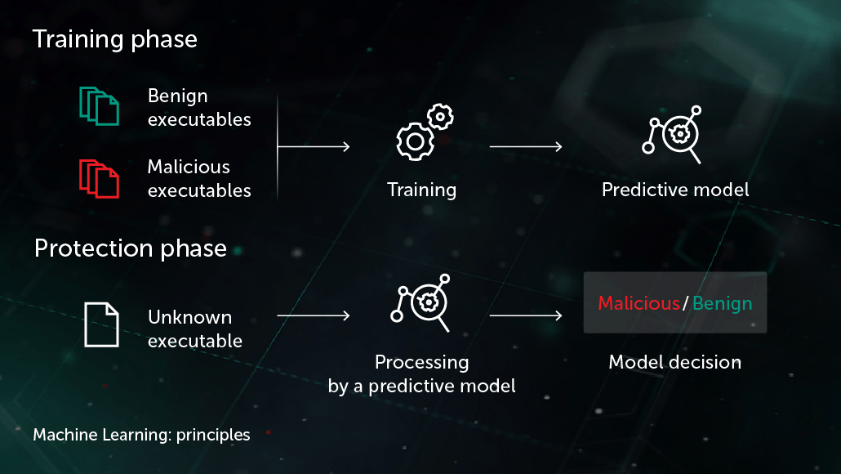

Slide 11
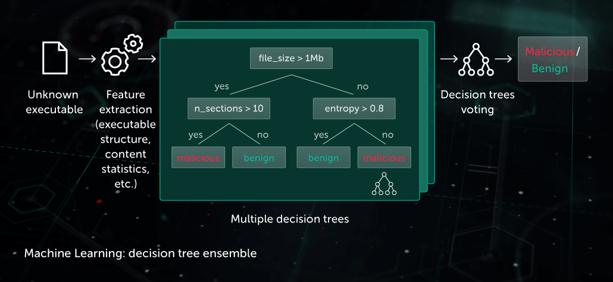

Slide 12
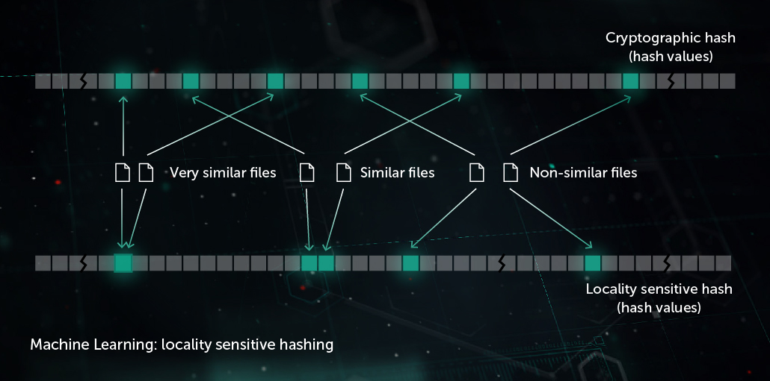

Slide 13
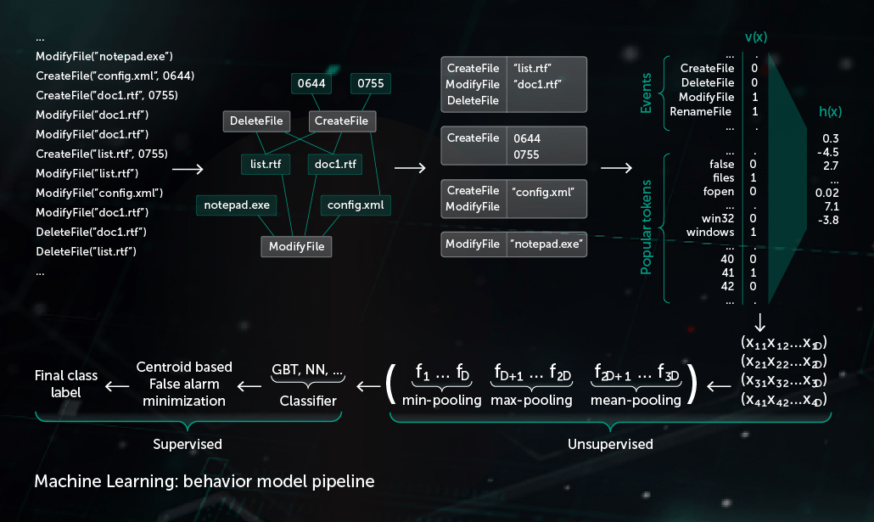

Slide 14
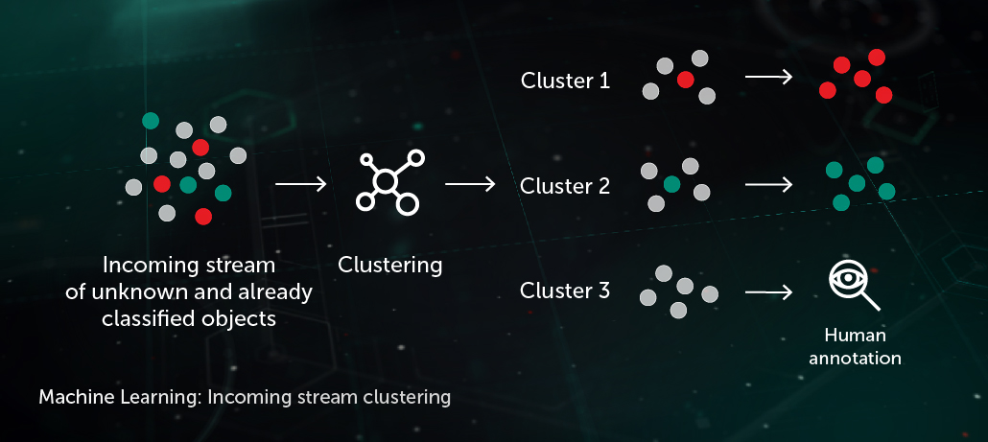

Slide 15

That’s it!

